Slide 1
Measurement of Energy-dependent Inclusive Muon Neutrino Charged-Current Cross Section at MicroBooNE
Wenqiang Gu
For the MicroBooNE collaboration
Brookhaven Forum, Nov 4th 2021
Notes:
Page 1 (title page): Good afternoon, everyone. My name is Wenqiang Gu. Today I am going to talk about Measurement of Energy-dependent Inclusive Muon Neutrino Charged-Current Cross Section at MicroBooNE.
---
Add photo?

Slide 2
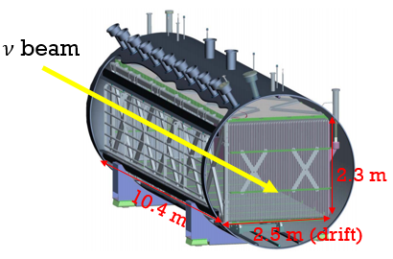
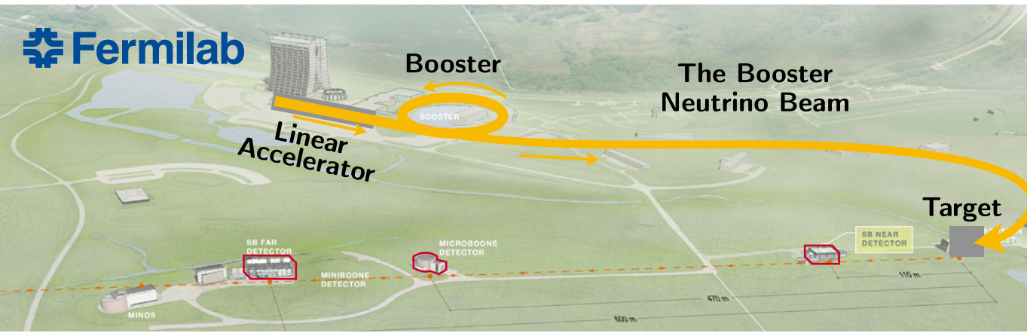
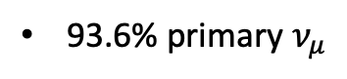
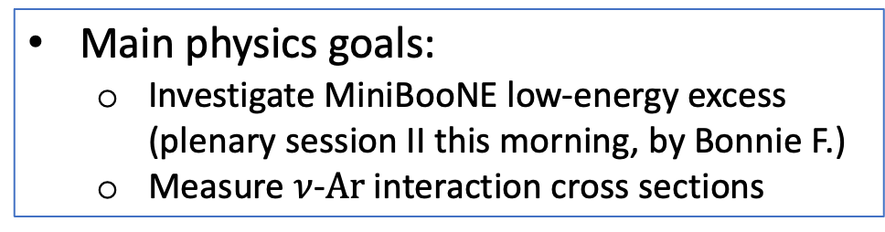
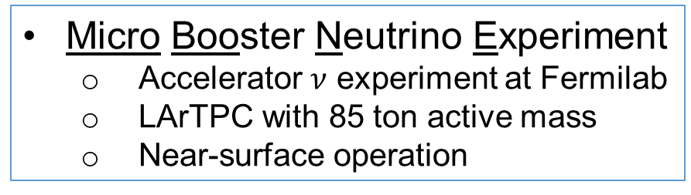
MicroBooNE Overview
Micro Booster Neutrino Experiment
Accelerator $ν$ experiment at Fermilab
LArTPC with 85 ton active mass
Near-surface operation
Main physics goals:
Investigate MiniBooNE low-energy excess (plenary session II this morning, by Bonnie F.)
Measure $ν$-$Ar$ interaction cross sections
MicroBooNE
MicroBooNE detector
Booster Neutrino Beam (BNB)
~ 0.8 GeV mean neutrino energy
93.6% primary $ν_{μ}$
Notes:
Page 2: MicroBooNE is an accelerator neutrino experiment at Fermilab, and is a LArTPC with 85 ton of active mass. The two of the main physics goals are to investigate the low-energy excess indicated by MiniBooNE as you have heard from Bonnie in this morning’s session, as well as to measure the neutrino-argon interaction cross section as I will be focusing on in this talk.
---
* Flux composition, energy, etc.
Another goal: R&D LArTPC for next generation neutrino experiment

Slide 3
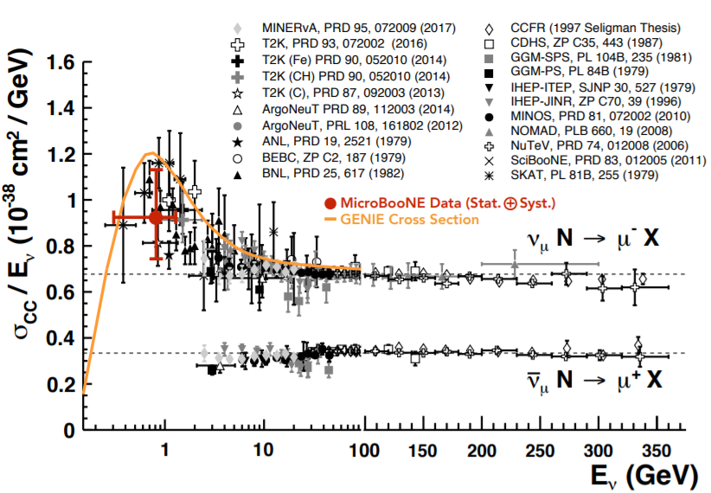
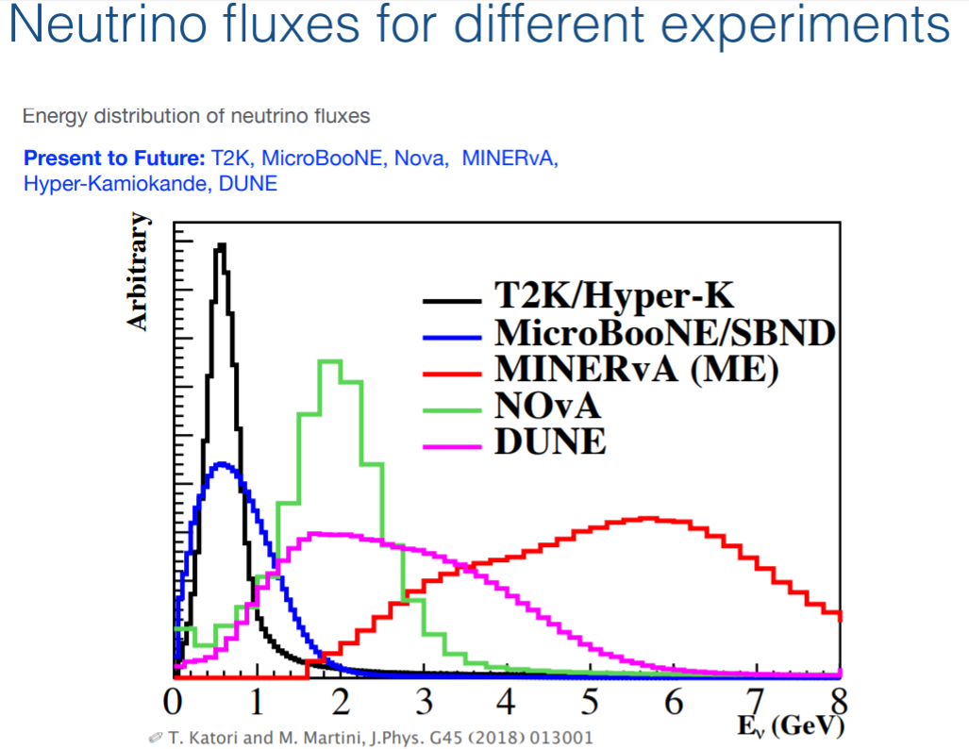
Measurements of Inclusive $ν_{μ}$Charged-Current (CC) Cross Section
(v2 based)
Review of Particle Physics
PDG, PTEP 2020 (2020) 8, 083C01
One of the most important systematics for precision accelerator neutrino oscillation measurement
Energy-dependent inclusive cross section is a good test of overall modeling of all the interaction processes, and form a good basis for the study of various exclusive interaction processes
Notes:
Page 3: So why are we interested in the inclusive muon-neutrino charged-current cross section? It is one of the most important systematics for a precision accelerator neutrino oscillation measurement. Additionally, the energy-dependent inclusive cross section is a good test of the overall modeling of all the interaction modes (like CCQE including 2p2h, CCRES), and it can form a good basis for exclusive channels (e.g. people may want to take a ratio measurement between the exclusive and the inclusive to reduce the systematic uncertainty)
---
Important systematic for oscillation analysis
Test model’s degree of freedom
The CC inclusive cross section is important to measure
There are not so many measurements at our energy
...and very few on argon
And that's potentially a problem for MicroBooNE, SBN, and DUNE measurements

Slide 4
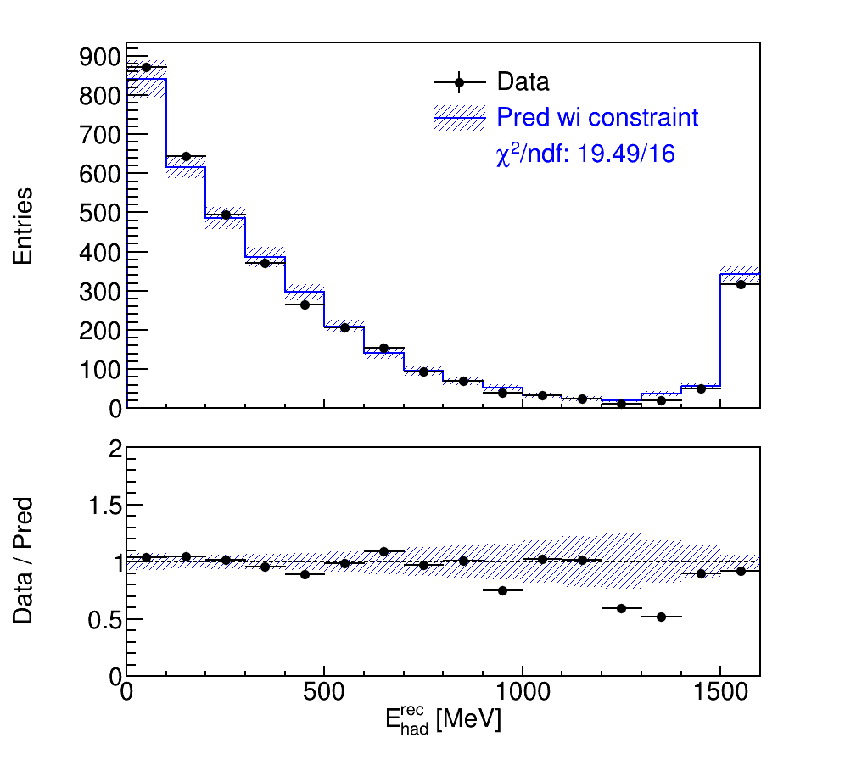
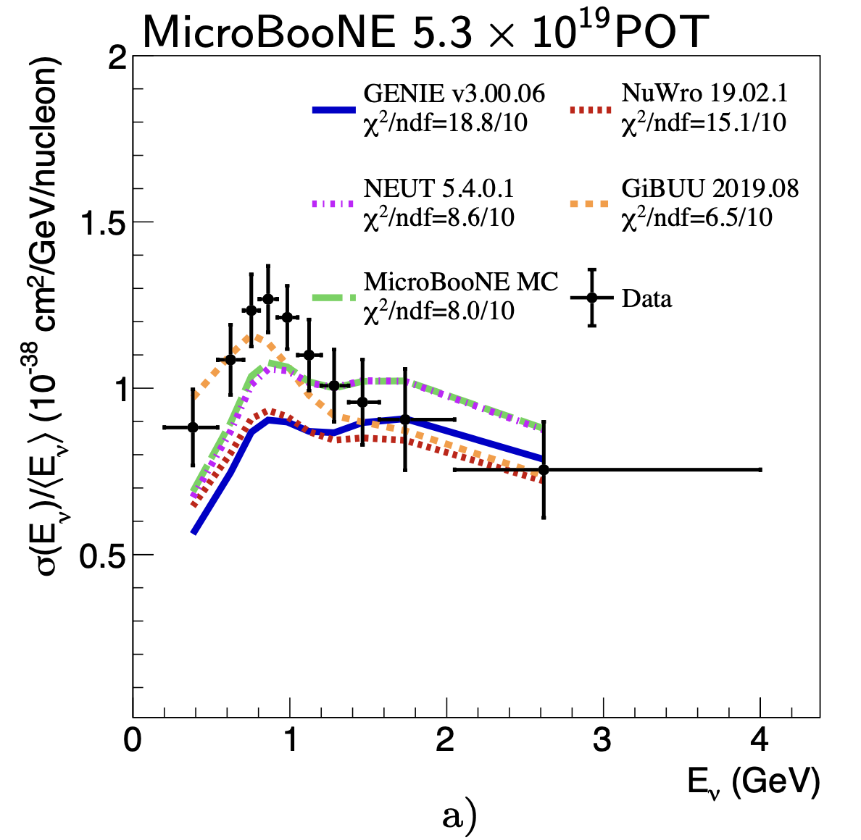
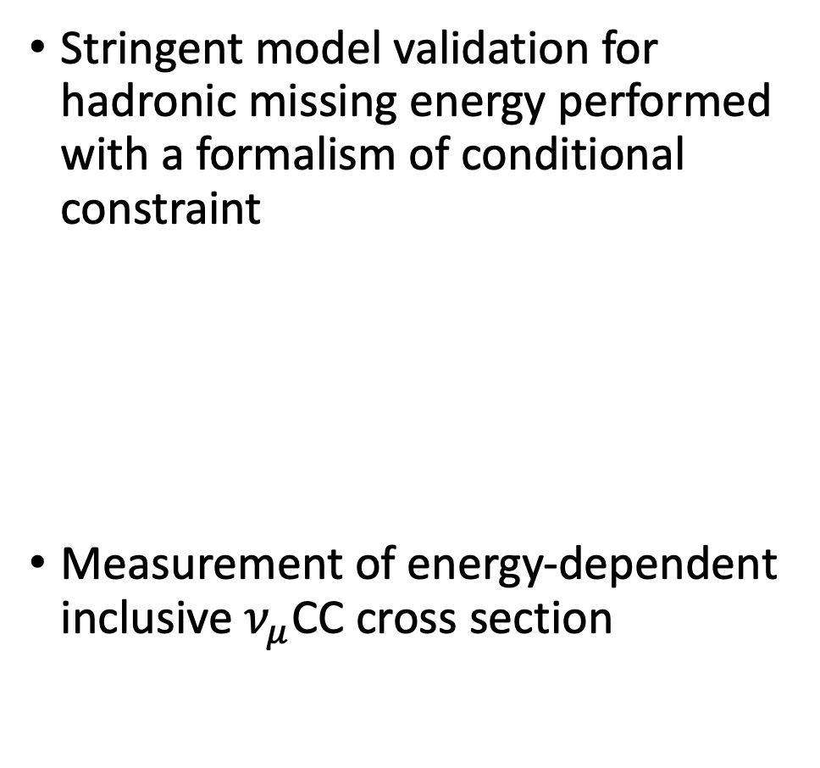
Highlights in This Talk
Stringent model validation for hadronic missing energy performed with a formalism of conditional constraint
Measurement of energy-dependent inclusive $ν_{μ}$CC cross section
After Constraint
FC
arXiv: 2110.14023
Notes:
Page 4: Today, my talk will be mainly covering on two parts. I will begin with the introduction of the stringent model validation for hadronic missing energy with a conditional constraint formalism. And later we will land on the measurement of the inclusive $ν_{μ}$CC cross section with an unfolding procedure.
---

Slide 5
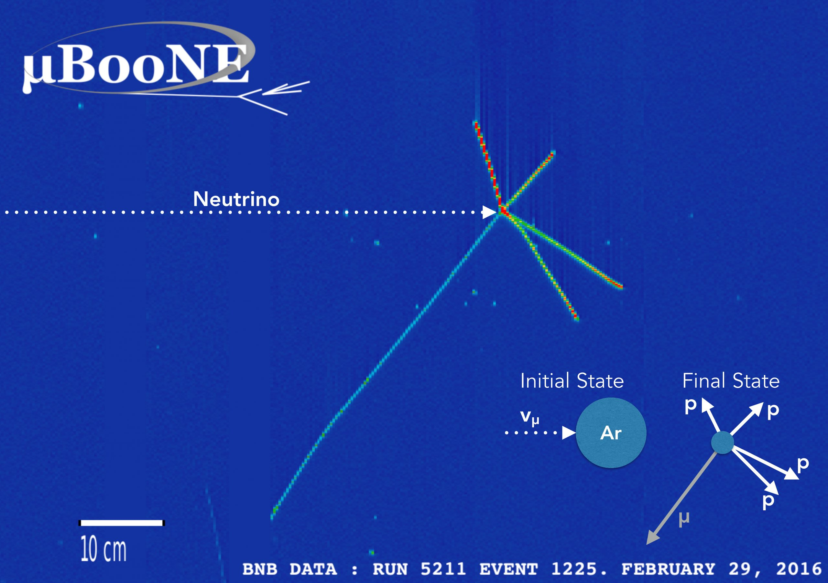
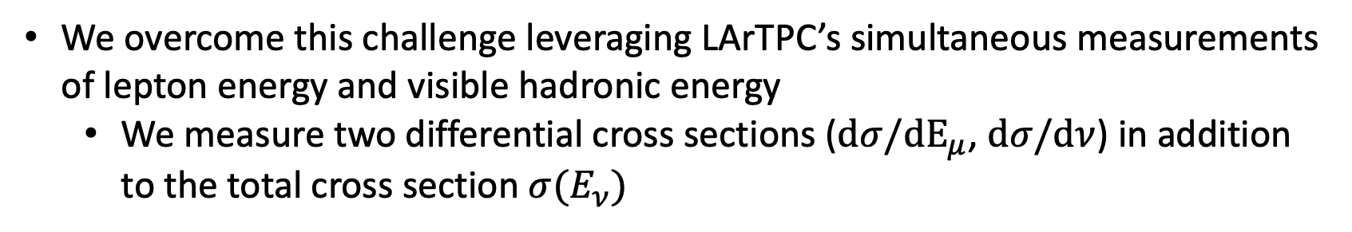

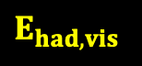

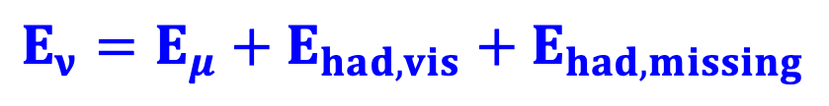
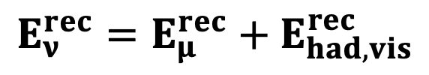
Energy Model Validation: True $E_{ν}$ to $E_{ν}^{rec}$
Neutrino energy modeling is also critical for neutrino oscillation measurements
Key challenge: verify the modeling of the undetectable missing hadronic energy
True energy components:
$$E_{ν}={E_{μ}+E}_{had,vis}+E_{had,missing}$$
$$E_{had,vis }$$
Calorimetric energy reconstruction:
$$E_{ν}^{rec}=E_{μ}^{rec}+E_{had, vis}^{rec}$$
$$E_{μ}$$
We overcome this challenge leveraging LArTPC’s simultaneous measurements of lepton energy and visible hadronic energy
We measure two differential cross sections ($dσ/dE_{μ}$, $dσ/dν$) in addition to the total cross section $σ(E_{ν})$
Notes:
Page 5: Let’s begin with the validation of the neutrino energy modeling. It is also critical for neutrino oscillation measurements. The key challenge is to verify the modeling of the undetectable missing hadronic energy (for example, the neutrons that exits the LArTPC). In this study, we overcome the challenge by leveraging the simultaneous measurement of lepton energy and hadronic energy in LArTPC. Finally, we report two differential cross section as a function of muon energy and hadronic energy transfer, as well as a total cross section as a function of neutrino energy.
---
LArTPC can separate lepton and hadronic energy from charged-current interactions
Key challenge: understanding 𝝂-Ar cross section as a function of energy

Slide 6
Verify the modeling of the missing hadronic energy at MicroBooNE
Notes:
Page 6 (transion page): To give you some details about this validation, I will be brief on our event selection and systematic uncertainties in the following two slides.
---

Slide 7

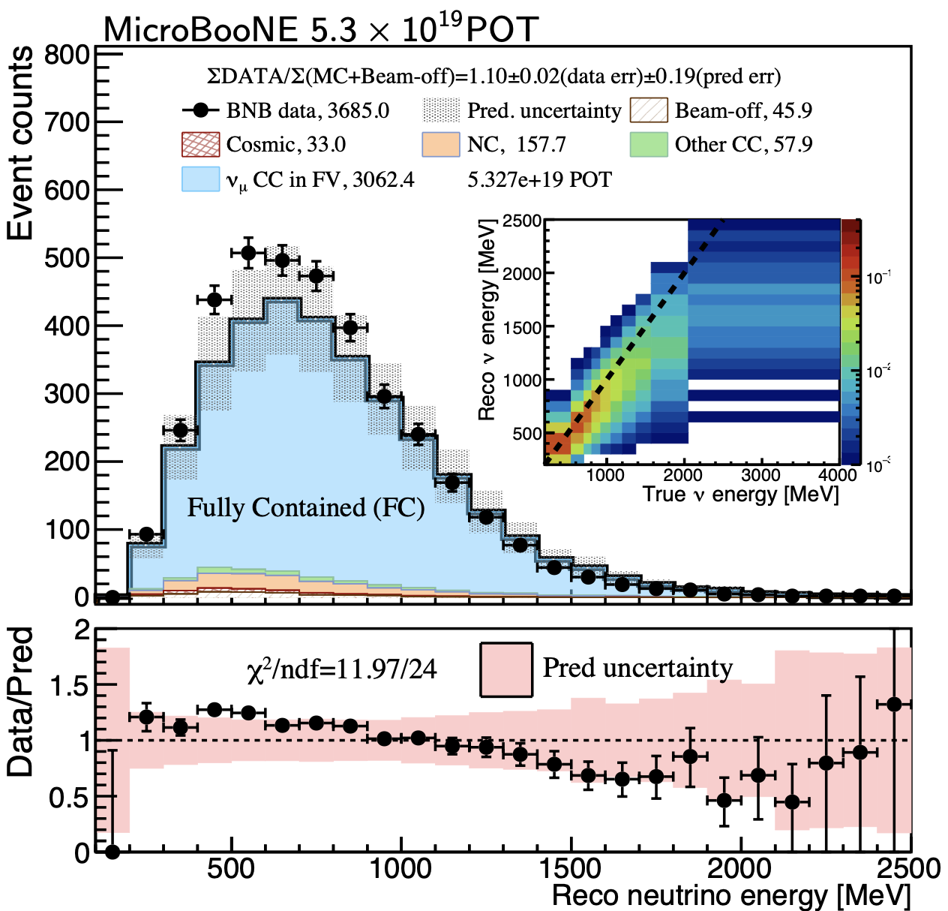

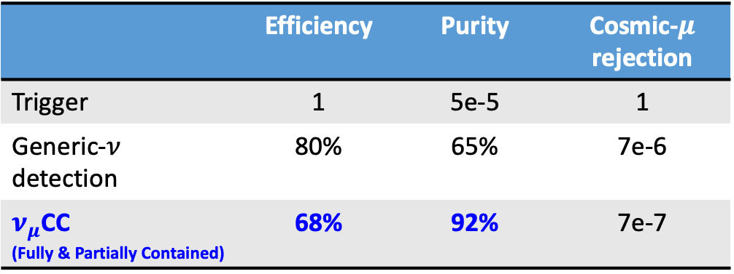
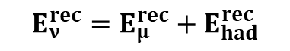
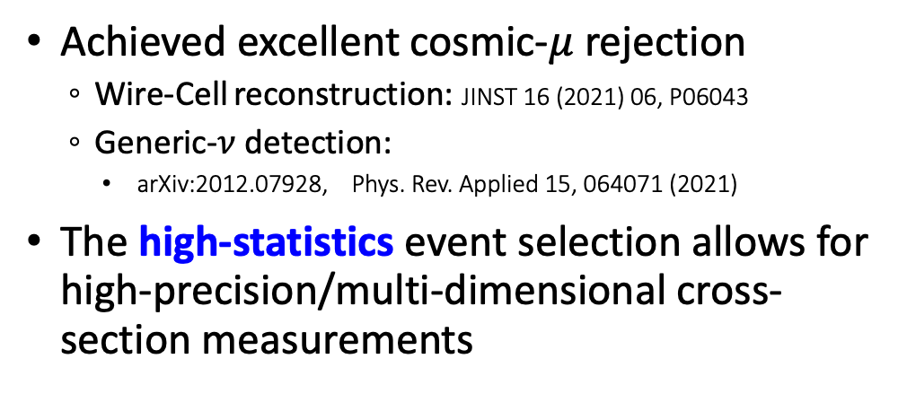
Selection of Inclusive Charged-Current $ν_{μ}$ Interactions
 | Efficiency | Purity | Cosmic-$μ$ rejection
Trigger | 1 | 5e-5 | 1
Generic-$ν$ detection | 80% | 65% | 7e-6
$ν_{μ}$CC (Fully & Partially Contained) | 68% | 92% | 7e-7
arXiv: 2110.14023
MC: GENIE v3 tune
Achieved excellent cosmic-$μ$ rejection
Wire-Cell reconstruction: JINST 16 (2021) 06, P06043
Generic-$ν$ detection:
arXiv:2012.07928, Phys. Rev. Applied 15, 064071 (2021)
The high-statistics event selection allows for high-precision/multi-dimensional cross-section measurements
Calorimetric energy:
$$E_{ν}^{rec}=E_{μ}^{rec}+E_{had}^{rec}$$
Notes:
Page 7: MicroBooNE is a near-surface detector, therefore, the key for a clean selection of the $ν_{μ}$ candidates is to reject cosmic muon. It is nontrivial as LArTPC is a slow readout detector. With the Wire-Cell reconstruction tool, a neutrino preselection is achieved with a cosmic rejection power of ~140,000. With additional $ν_{μ}$ CC selection algorithm, the S/B ratio is further improved with a factor more than 5.
The high-statistics event selection allows for a high-precision …
The figure shows you the reconstructed energy distribution for the $ν_{μ}$ CC candidates, overlayed with the MC prediction. The difference between data and MC is covered by the systematic uncertainties in the grey band.
---
s/N ratio
Cosmic rejection (directionality) & NC
Elena: try more concise bullets
Kirsty: try different color for sub-bullets and highlight the main text
Difference is covered by the uncertainty, no impact on LEE analysis
Genie version 3 + uB tune (fit world data, T2K QE similar energy, no miniboone, no microboone)
Cite GENIE (see technote)
LArTPC is a “slow” detector: time -> position. On the surface, cosmic background

Slide 8
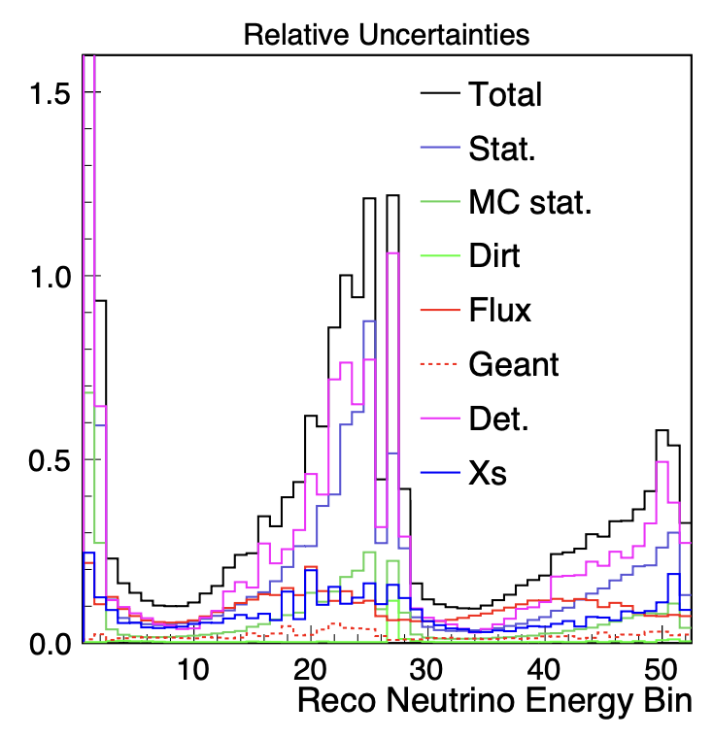
Systematic Uncertainties
BNB neutrino flux uncertainty
MiniBooNE: Phys. Rev. D79, 072002
Neutrino cross section uncertainty
GENIE-v3 with the MicroBooNE tune: arXiv:2110.14028
Detector systematics
TPC, Light, Space Charge, Recombination
Bootstrapping approach
Hadron-argon interaction uncertainty
GEANT4 reweight
MC statistical uncertainty
Bayesian approach
Dirt systematics
Materials outside the cryostat
Fully contained (FC)
Partially contained (PC)
Notes:
Page 8: For the systematic uncertainty, it has contributions from several components, where the detector modeling uncertainty is dominating the total uncertainty, and the flux, cross section, statistical uncertainty is sub dominating. The other factors e.g., hadron-argon interaction uncertainty and the material modeling surrounding the cryostat is small but not ignored.
---

Slide 9
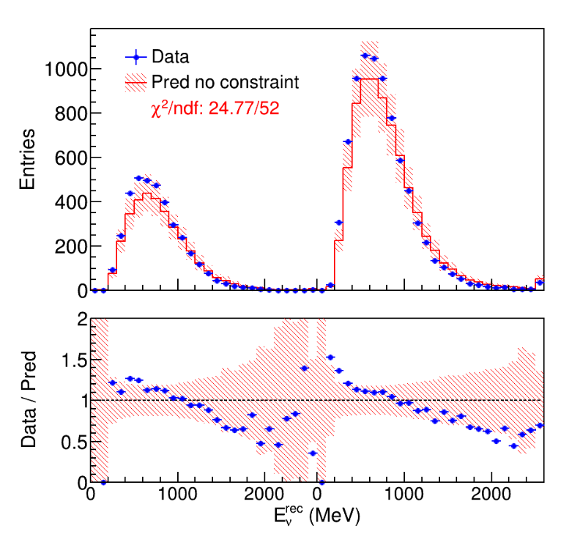
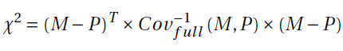
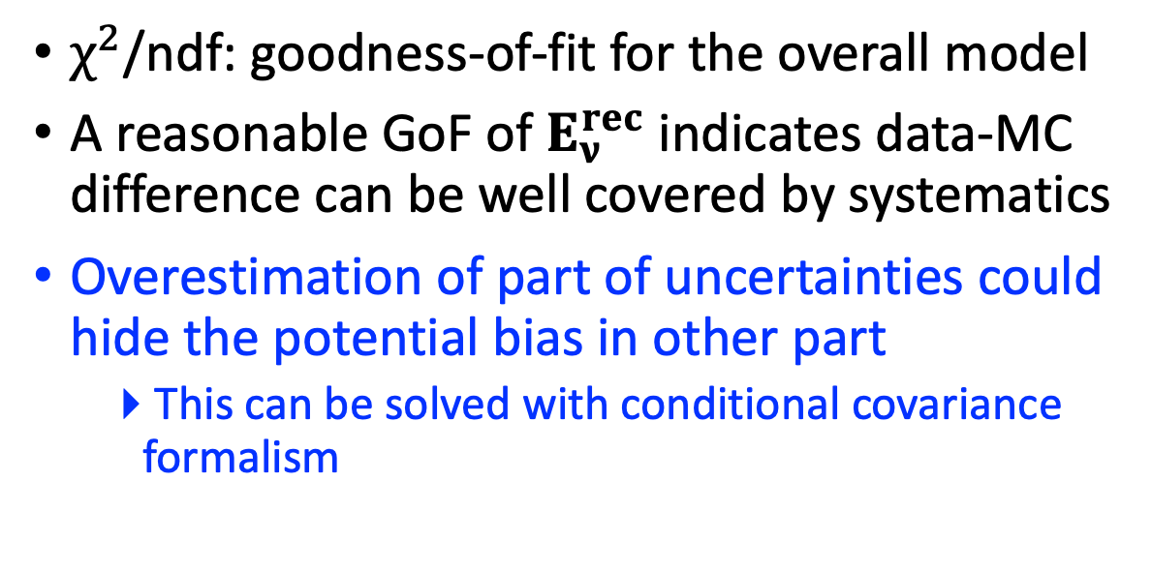
Model Validation: Goodness-of-Fit (GoF)
A covariance matrix is built from the full systematics (flux, Xs, detector, MC statistics) and statistics
MicroBooNE (5.327E19 POT)
$χ^{2}$/ndf: goodness-of-fit for the overall model
A reasonable GoF of $E_{ν}^{rec}$ indicates data-MC difference can be well covered by systematics
Overestimation of part of uncertainties could hide the potential bias in other part
This can be solved with conditional covariance formalism
FC
PC
Calorimetric energy:
$$E_{ν}^{rec}=E_{μ}^{rec}+E_{had}^{rec}$$
Notes:
Page 9: Now given the full systematics, a covariance matrix is constructed, and a value of chi2/ndf is calculated, providing a goodness-of-fit for the overall model.
For example, the reconstructed neutrino energy distribution is compared with the model prediction. Both the fully contained and partially contained sample are tested. The reasonable chi2/ndf value indicates that the data-MC difference can be well covered by the total systematic uncertainty.
However, there is a concern. It is possible that part of the uncertainties is overestimated and it could hide the potential bias in the other component of uncertainty. For example, the flux uncertainty is conservative, therefore, it could hide some bias in the cross section interaction model. In this study, we show that this concern can be solved with a formalism of conditional covariance.
---
Add animation
Introduce a tool in this slide

Slide 10
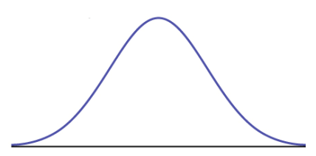
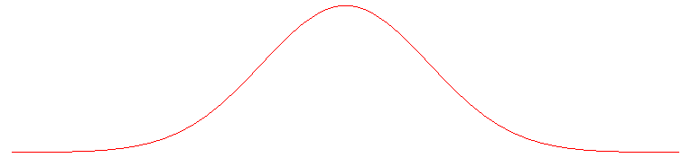
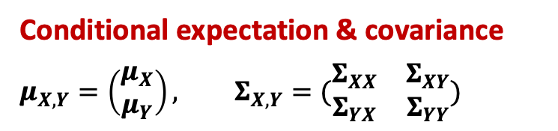
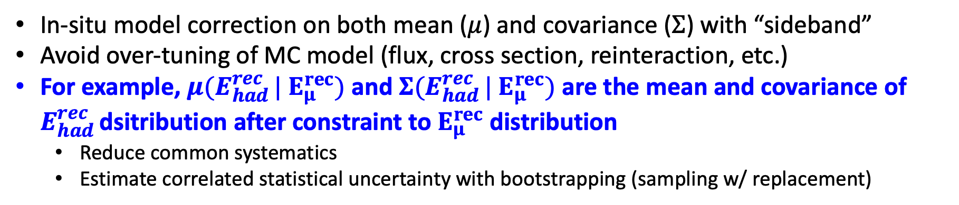
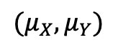
Conditional expectation & covariance
Conditional expectation & covariance
$$μ_{X,Y}=\left(\begin{matrix}μ_{X} \\ μ_{Y}\end{matrix}\right), Σ_{X,Y}=(\begin{matrix}Σ_{XX} & Σ_{XY} \\ Σ_{YX} & Σ_{YY}\end{matrix})$$
$$μ_{Y|X}=μ_{Y}+Σ_{YX}Σ_{XX}^{−1}\left(X−μ_{X}\right)$$
$$Σ_{Y|X}=Σ_{YY}−Σ_{YX}Σ_{XX}^{−1}Σ_{XY}$$
$$(μ_{X},μ_{Y})$$
After Constraint
Before Constraint
* A variant of Gaussian Process regression
X
In-situ model correction on both mean ($μ$) and covariance ($Σ$) with “sideband”
Avoid over-tuning of MC model (flux, cross section, reinteraction, etc.)
For example, ${μ(E}_{had }^{rec}| E_{μ}^{rec})$ and ${Σ(E}_{had }^{rec}| E_{μ}^{rec})$ are the mean and covariance of $E_{had }^{rec}$dsitribution after constraint to $E_{μ}^{rec}$ distribution
Reduce common systematics
Estimate correlated statistical uncertainty with bootstrapping (sampling w/ replacement)
Notes:
Page 10: To remind you, conditional expectation and covariance has a same backend formular as in the Gaussian Process Regression. It assumes two normally distributed variable vector, given a measurement in one variable, it leads to a constraint of phase space in the other variable. In the other word, this is a data driven model correction on both the mean and variance with auxiliary sidebands. It avoids over-tuning of MC models.
For example, the model prediction of the reconstructed hadronic energy distribution can be constrained with the measured distribution of the reconstructed muon energy distribution. As a result, the common systematics such as flux are largely reduced, where the correlated statistical uncertainty between hadronic energy and muon energy is estimated with bootstrapping procedure.
---

Slide 11
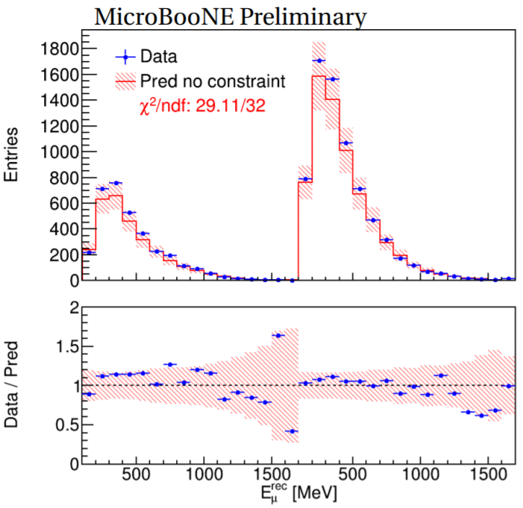
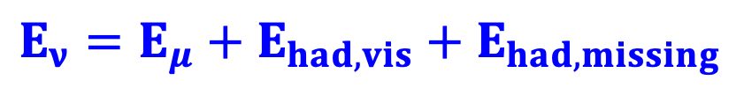
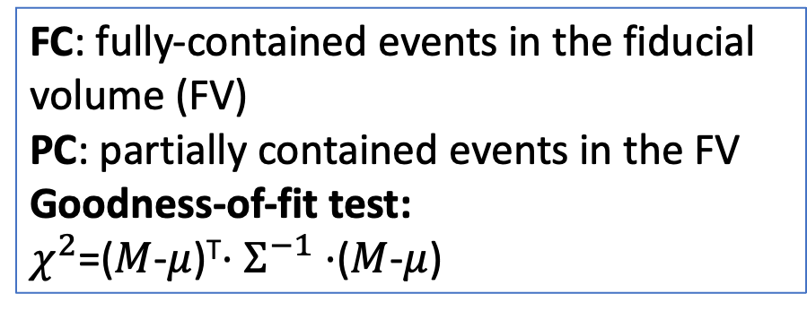
Model Validation: M($E_{μ}^{rec}$) vs. $μ$($E_{μ}^{rec}$)
LArTPC can separate lepton and hadronic energy from charged-current interactions
$$E_{ν}={E_{μ}+E}_{had,vis}+E_{had,missing}$$
FC: fully-contained events in the fiducial volume (FV)
PC: partially contained events in the FV
Goodness-of-fit test:
$χ^{2}$=($M$-$μ$)^{T}$⋅Σ^{−1}⋅$($M$-$μ$)
FC
PC
Good agreement within model uncertainty given that $χ^{2}$/ndf = 29.11/32
Notes:
Page 11: First, let’s take a look at the overall model validation at the lepton side. The reconstructed energy for muon final state is compared with model prediction, the chi2/ndf value looks reasonable.
---
LArTPC can separate lepton and hadronic energy from charged-current interactions
Key challenge: understanding 𝝂-Ar cross section as a function of energy

Slide 12
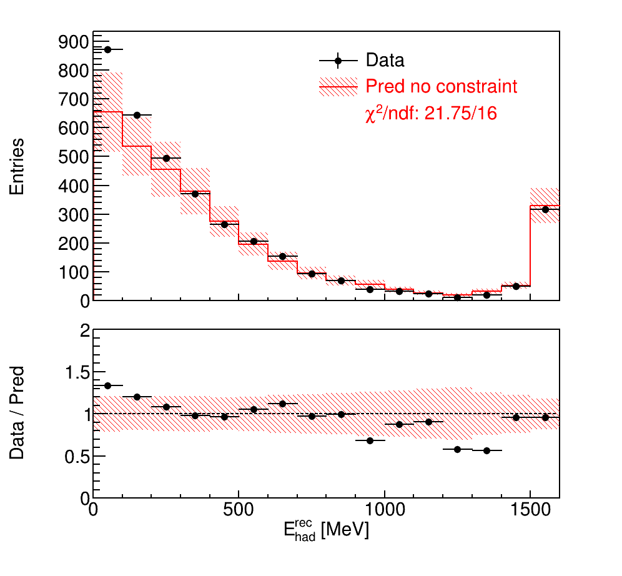

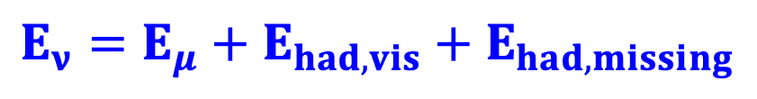
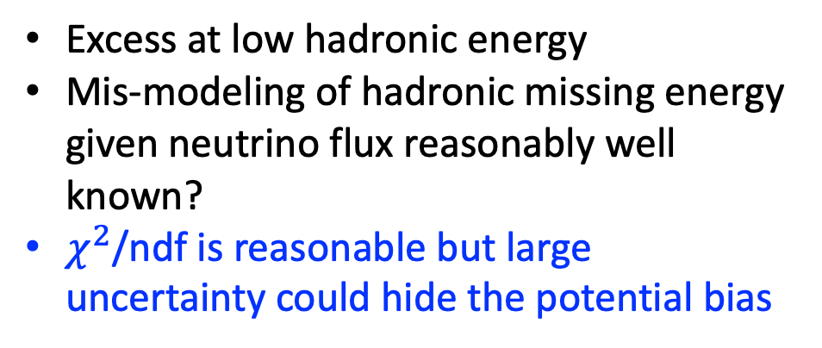
Model Validation: M($E_{had}^{rec}$) vs. $μ$($E_{had}^{rec}$)
LArTPC can separate lepton and hadronic energy from charged-current interactions
$$E_{ν}={E_{μ}+E}_{had,vis}+E_{had,missing}$$
Excess at low hadronic energy
Mis-modeling of hadronic missing energy given neutrino flux reasonably well known?
$χ^{2}$/ndf is reasonable but large uncertainty could hide the potential bias
Before Constraint
Overflow
FC
Solution: lepton-side measurement can be used to constrain the overall model (flux, cross section, etc.)
Notes:
Page 12: Next, a data-MC comparison is done for the reconstructed hadronic energy. The overall chi2/ndf looks reasonable, but there is a little excess at low hadronic energy. Could it be a mis-modeling of the hadronic missing energy given the neutrino flux reasonably well known? The total uncertainty at low energy is about 20%, limiting our ability to investigate the potential bias.
The solution is that we can use the kinematic distributions from the muon final state to reduce the total uncertainty from the common systematic components (e.g., flux, cross section).
---

Slide 13
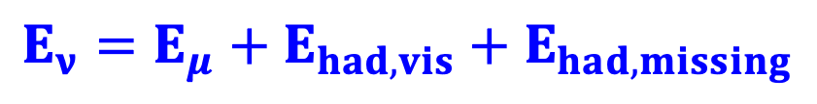
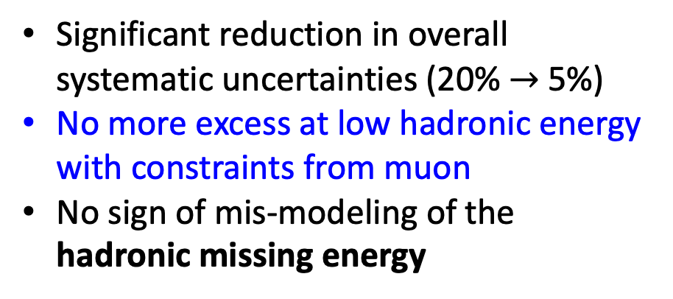
Model Validation: M($E_{had}^{rec}$) vs. $μ$($E_{had}^{rec}$ | $E_{μ}^{rec},cosθ_{μ}^{rec}, E_{ν}$)
LArTPC can separate lepton and hadronic energy from charged-current interactions
$$E_{ν}={E_{μ}+E}_{had,vis}+E_{had,missing}$$
Measured muon kinematics are used to constrain the overall model (flux, cross section, etc.) for hadronic energy
Before Constraint
After Constraint
Overflow
Significant reduction in overall systematic uncertainties (20% $→$ 5%)
No more excess at low hadronic energy with constraints from muon
No sign of mis-modeling of the hadronic missing energy
FC
Notes:
Page 13: Finally, this is the hadronic energy distribution with a constraint to the muon kinematics …
---
Notation sonsistent with p12

Slide 14
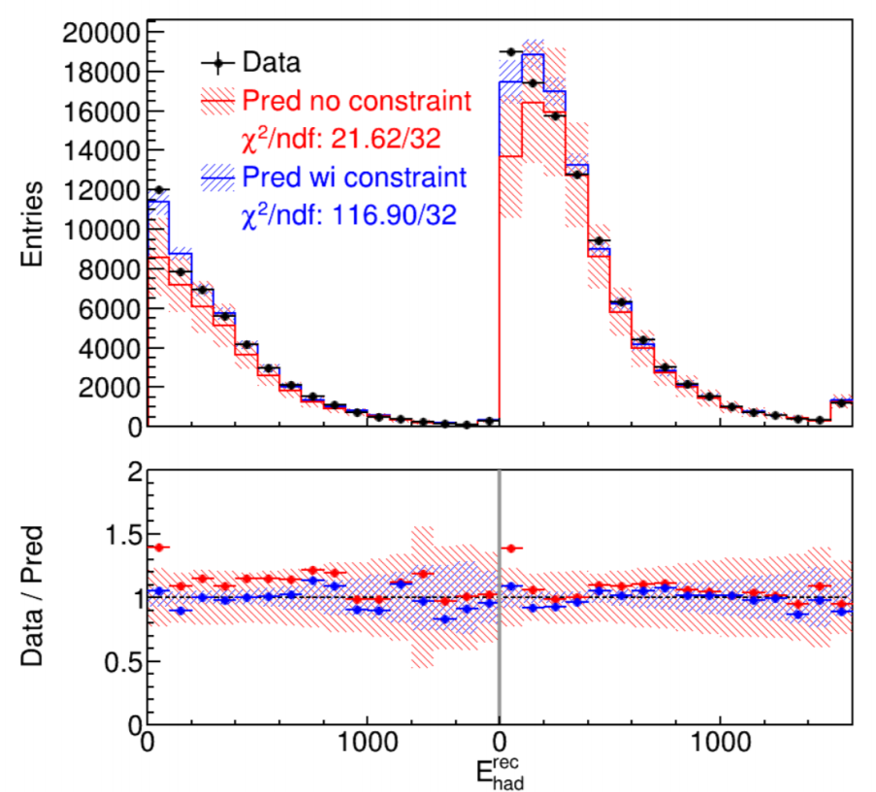
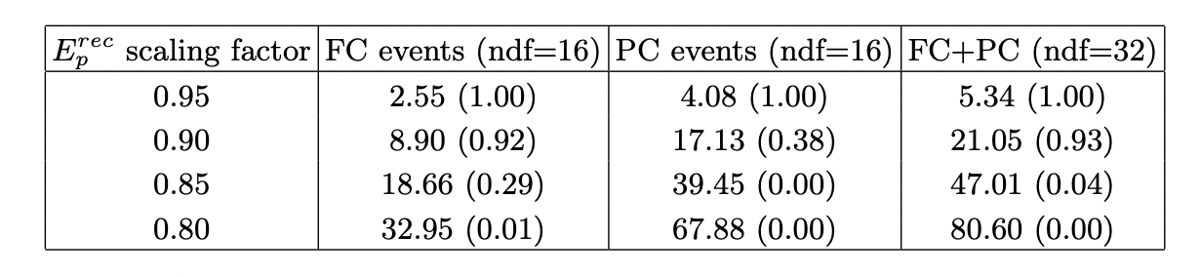
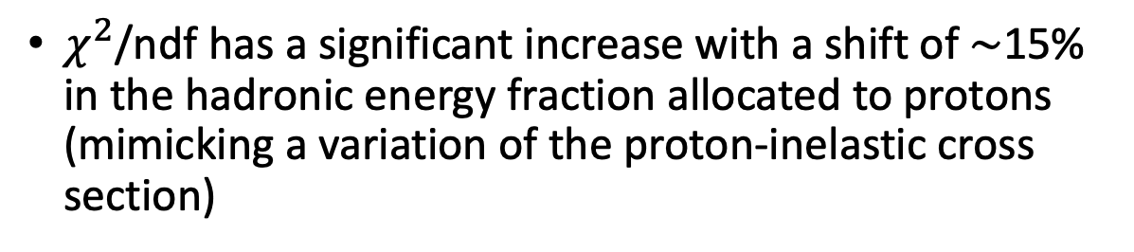
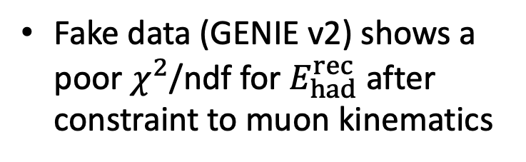
Is the new method really working?
fake data
FC
PC
$χ^{2}$/ndf has a significant increase with a shift of ∼15% in the hadronic energy fraction allocated to protons (mimicking a variation of the proton-inelastic cross section)
Fake data (GENIE v2) shows a poor $χ^{2}$/ndf for $E_{had}^{rec}$ after constraint to muon kinematics
The conditional constraint approach is sensitive to the underlying model difference
Notes:
Page 14: Now you might ask a question: is this new validation method really work? Here, I am showing you two fake data studies. The left one is the fake data generated based on the old version generator GENIE v2. It has been shown that the chi2/ndf is large after the constraint to muon kinematics. The right handed table shows another set of fake data study, where the hadronic energy fraction allocated to protons has been reduced with different percentages, mimicking a variation in the proton-inelastic scattering). It has shown that ch2/ndf increases significantly large with a shift of ~15%, smaller than the more conservatively assigned uncertainty in the GENIE generator.
All these shows that the conditional constraint approach is sensitive to the underlying model difference.
---
Move fake data before the real data for a seminar talk

Slide 15
Cross Section Unfolding
Notes:
Page 15: Now I would like to move on to the cross section unfolding.
---

Slide 16
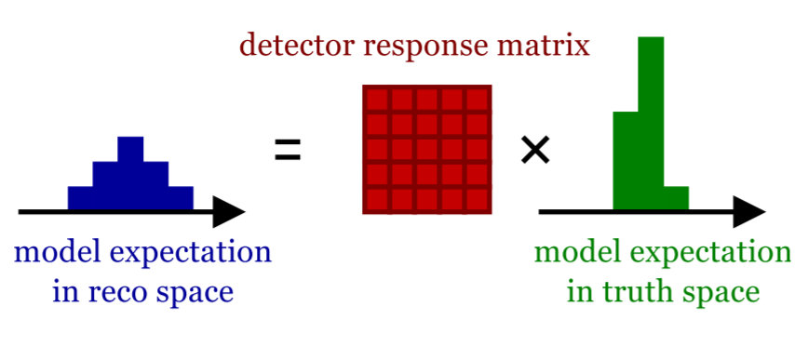
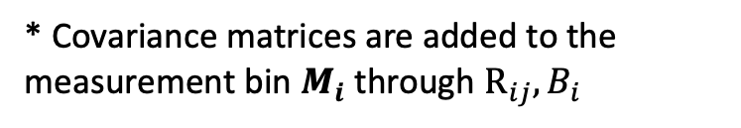

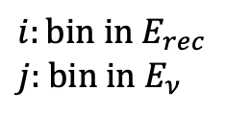
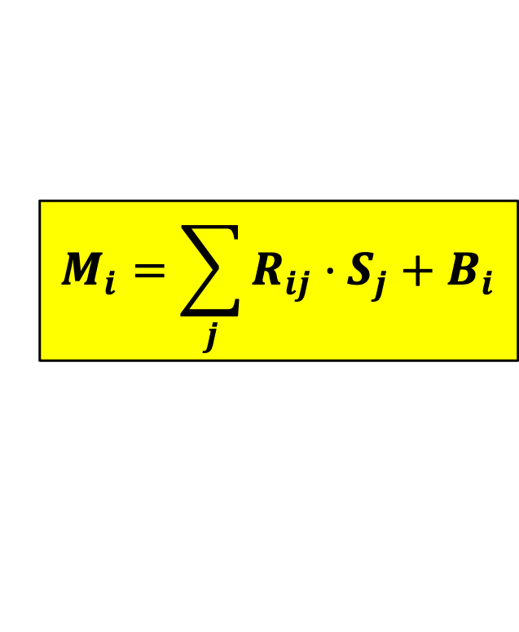
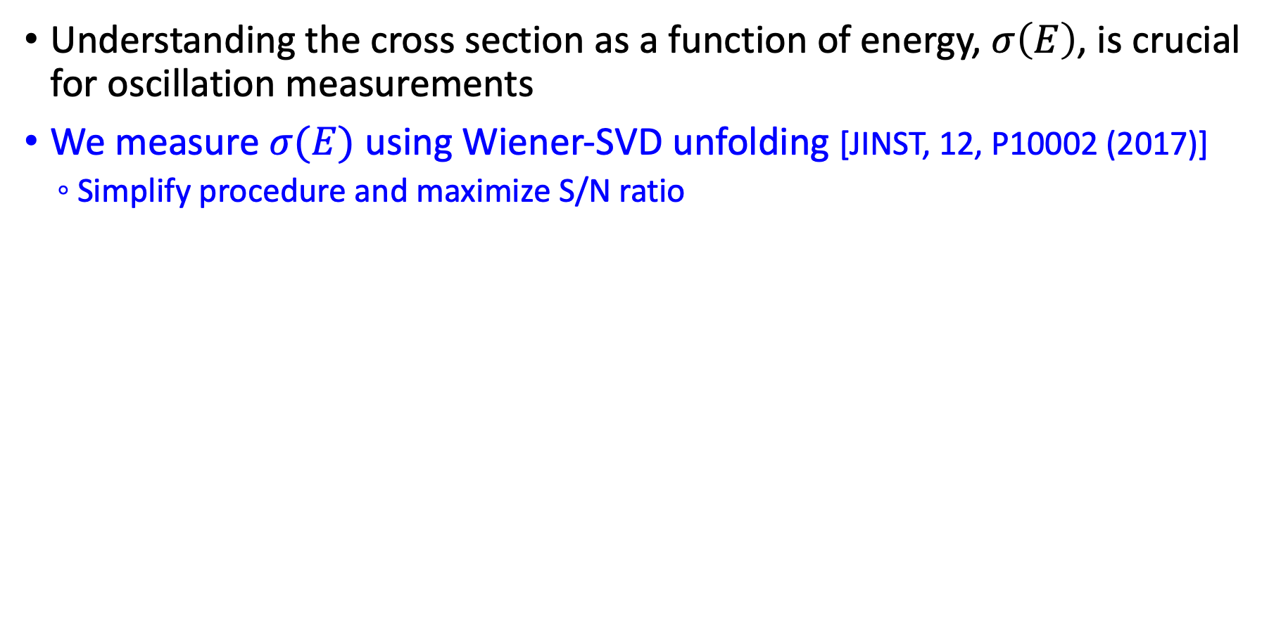
Towards $σ(E)$ with Unfolding
Understanding the cross section as a function of energy, $σ\left(E\right)$, is crucial for oscillation measurements
We measure $σ(E)$ using Wiener-SVD unfolding [JINST, 12, P10002 (2017)]
Simplify procedure and maximize S/N ratio
$$M_{i}=\sum_{j}{R_{ij}⋅S_{j}}+B_{i}$$
$$i:\text{bin} \text{in} E_{rec}$$
$$j\text{: }\text{bin} \text{in} E_{ν}$$
* Covariance matrices are added to the measurement bin $M_{i}$ through $R_{ij}, B_{i}$
Notes:
Page 16: Understanding the cross section as a function of energy is also crucial for oscillation measurement. In this study, we measure the energy-dependent total cross section using the Wiener-SVD unfolding. I am not going to expand the details about the technical formalism but Wiener-SVD unfolding simplify the procedure and maximize S/N ratio.
Unfolding is basically a technique to extract the underlying true model given the reconstructed distribution and a proper modeling of the detector response. We can do an extraction of the cross section if we can write down a master equation, where the measured neutrino energy distribution is modeled with the background prediction and the response matrix, and the cross section can be maintained in the signal term.
---
Unfolding: The process of extracting information about the truth content given the observed measurements

Slide 17

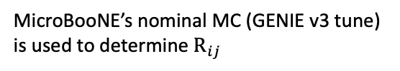
Cross Section Extraction
Measurements
Flux
Cross section
Detector response
Selection efficiency
Background
$$M\left(E_{rec}\right)=POT⋅T⋅\int{F\left(E_{ν}\right)⋅σ\left(E_{ν}\right)}⋅D\left(E_{ν},E_{rec}\right)⋅ε\left(E_{ν},E_{rec}\right)⋅dE_{ν}+B\left(E_{rec}\right)$$
Refactorized
$$M_{i}=\sum_{j}{R_{ij}⋅S_{j}}+B_{i}$$
MicroBooNE’s nominal MC (GENIE v3 tune) is used to determine $R_{ij}$
Notes:
Page 17/18: To rephrase this problem. Let’s write down the neutrino measurement as a convolution of the number of target, flux , cross section, detector and selection efficiency, as well as background.
---
Extraction of total ν_{μ}CC cross section as neutrino energy

Slide 18
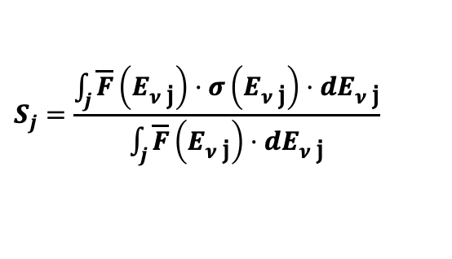
Cross Section Extraction
Measurements
Flux
Cross section
Detector response
Selection efficiency
Background
$$M\left(E_{rec}\right)=POT⋅T⋅\int{F\left(E_{ν}\right)⋅σ\left(E_{ν}\right)}⋅D\left(E_{ν},E_{rec}\right)⋅ε\left(E_{ν},E_{rec}\right)⋅dE_{ν}+B\left(E_{rec}\right)$$
Refactorized
$$M_{i}=\sum_{j}{R_{ij}⋅S_{j}}+B_{i}$$
$$S_{j}=\frac{\int_{j}{\overline{F}\left(E_{ν \text{j}}\right)⋅σ\left(E_{ν \text{j}}\right)⋅dE_{ν \text{j}}}}{\int_{j}{\overline{F}\left(E_{ν \text{j}}\right)⋅dE_{ν \text{j}}}}$$
Nominal-flux averaged cross section
MicroBooNE’s nominal MC (GENIE v3 tune) is used to determine $R_{ij}$
* Proper treatment of flux shape uncertainty: PhysRevD.102.113012
Notes:
(page 18) To simplify the treatment of the systeamatic uncertainty, our signal is defined as the cross section in each energy bin and weigted averaged by flux spectrum.
The advantage of this definition is that it can address a recent concern from the community about the treatment of the flux shape uncertainty.
---
Extraction of total ν_{μ}CC cross section as neutrino energy

Slide 19

Result (I): Total Cross Section $σ(E)$
Wiener regularization applied to each generator’s model prediction for a proper data comparison
GiBUU, NEUT and MicroBooNE GENIE tune all give reasonable agreement
arXiv: 2110.14023
Notes:
Page 19: So it brings me to the final result. The data points are shown and overalyed with the central prediction from several state-of-the-art event generators. The wiener regulization is added to the model prediction for a proper data comparison. The GiBUU, NEUT, and the MicroBooNE GENIE tune all give reaonsonable agreement.
---
Introducer the generators (GENIE US, NEUT JP, Nuwro, GiBUU), what’s the difference in model? How about GiBUU
Overlay with Sam’e plot (ask for the script) introduce Emu nu plots first, finally show total Xs

Slide 20
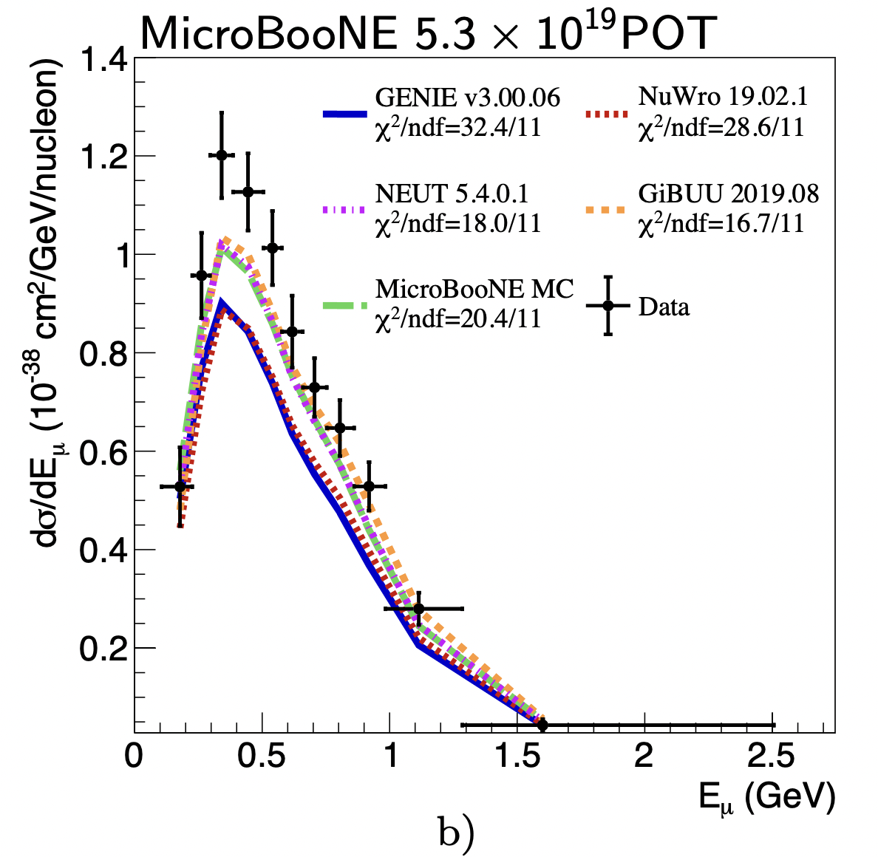
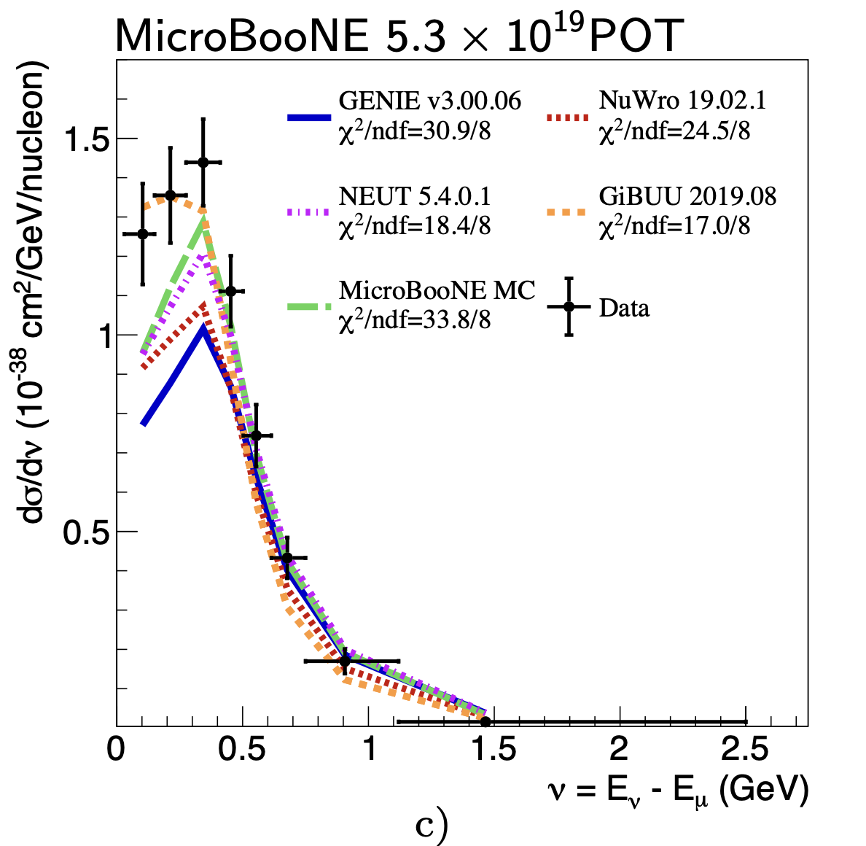
Result (II): Differential Cross Section
arXiv: 2110.14023
First-time on argon
Differential cross section as a function of:
Muon energy: reasonable agreement in shape but differ in normalization for all generators
Hadronic energy transfer: GiBUU gives best agreement at low energy transfer
Notes:
Page 20: Similarly, we also measured two differential cross section. One is as a function of …, the other is … For the muon energy one, a reasonable … For the hadronic energy transfer one, GiBUU gives best agreement at low energy transfer.
---

Slide 21
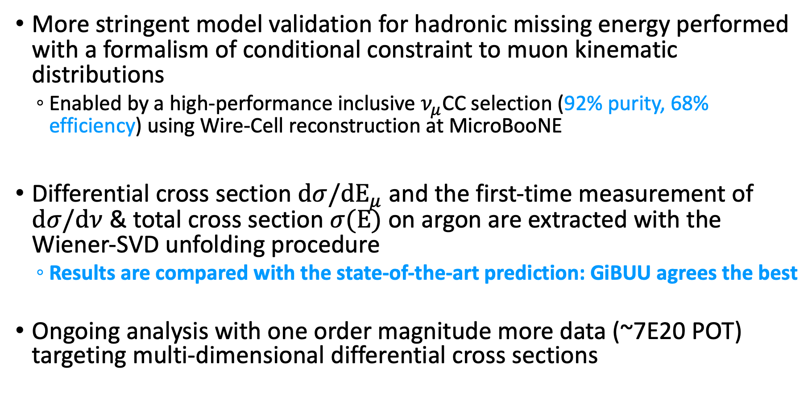
Summary
More stringent model validation for hadronic missing energy performed with a formalism of conditional constraint to muon kinematic distributions
Enabled by a high-performance inclusive $ν_{μ}$CC selection (92% purity, 68% efficiency) using Wire-Cell reconstruction at MicroBooNE
Differential cross section $dσ/dE_{μ}$ and the first-time measurement of $dσ/dν$ & total cross section $σ(E)$ on argon are extracted with the Wiener-SVD unfolding procedure
Results are compared with the state-of-the-art prediction: GiBUU agrees the best
Ongoing analysis with one order magnitude more data (~7E20 POT) targeting multi-dimensional differential cross sections
Notes:
Page 21: It brings me to my short summary now. …
---
Improved cross-section model and uncertainty described by the recent MicroBooNE GENIE tune with T2K CC0$π$ data
Seminar: reco, inclusive event selection; GENIE model; systematic uncertainty; MicroBooNE review of Xs, my improvement; Explain Wiener-SVD; Expand result (separate model generator, physics in generaotrs. What does it mean for GiBUU’s best performance); nominal-flux based Xs (shape uncertainty treatment)

Slide 22
Backup Slides

Slide 23









Strategy for Further Validating the Hadronic Missing Energy
Consider an idea case: a mono-energetic neutrino beam
The measured muon energy distribution can adjust the model prediction of hadronic energy and its uncertainty
$$E_{had}^{rec}$$
$E_{missing}$=0
$$E_{had}^{rec}$$
$E_{missing}$=0
After constraint w/ muon kinematics
$Δ$ (missing erg.)
$Δ$ (missing erg.)
$$E_{μ}^{rec}$$
$$E_{μ}^{rec}$$
prediction
measurement
posterior prediction
We do not directly measure missing energy, while the agreement in the measured hadronic energy proves the proper modeling of missing energy

Slide 24








What if an incorrect modeling of missing energy?
$$E_{had}^{rec}$$
$$E_{had}^{rec}$$
$E_{missing}$=0
$Δ$ (missing erg.)
$$Δ$$
$$E_{μ}^{rec}$$
$$E_{μ}^{rec}$$
posterior prediction
posterior prediction
(a) Correct model of missing energy
(b) Incorrect model of missing energy
An incorrect missing energy model cannot give a consistent posterior prediction (after $E_{μ}^{rec}$constraint) of the measured $E_{had}^{rec}$
The example here is just for illustration, the actual constraint relies on various kinematic distributions

Slide 25






MicroBooNE GENIE Tune
MicroBooNE has recently made significant upgrades to its neutrino interaction model (arxiv: 2110.14028)
GENIE v3 based RPA, 2p2h
Theory-driven tuning to T2K CC0$π$ data
$dσ^{2}$/${dP}_{μ}d\cos_{θ}$
$P_{μ}$ (GeV/c)
Before tuning
After Tuning
Notes:
What’s the improvement in GENIE v3

Slide 26






Cross Section Extraction
Measurements
ν_{μ}CC cross section
Detector response matrix
Selection efficiency
ν_{μ} Neutrino Flux
Background
$$M\left(E_{rec}\right)=POT⋅T⋅\int{F\left(E_{ν}\right)⋅σ\left(E_{ν}\right)}⋅D\left(E_{ν},E_{rec}\right)⋅ε\left(E_{ν},E_{rec}\right)⋅dE_{ν}+B\left(E_{rec}\right)$$
$$M_{i}=\sum_{j}{R_{ij}⋅S_{j}}+B_{i}$$
$${\tilde{F}}_{j}=POT⋅T⋅\int_{j}{\overline{F}\left(E_{ν \text{j}}\right)⋅dE_{ν \text{j}}}$$
$$R_{ij }={\tilde{Δ}}_{ij} {\tilde{F}}_{j}$$
$${\tilde{Δ}}_{ij}=\frac{POT⋅T⋅\int_{j}{F\left(E_{ν \text{j}}\right)⋅σ\left(E_{ν \text{j}}\right)⋅D\left(E_{ν \text{j}},E_{rec i}\right)}⋅ε\left(E_{ν \text{j}},E_{rec i}\right)⋅dE_{ν \text{j}}}{POT⋅T⋅\int_{j}{\overline{F}\left(E_{ν \text{j}}\right)⋅σ\left(E_{ν \text{j}}\right)⋅dE_{ν \text{j}}}}$$
$$S_{j}=\frac{\int_{j}{\overline{F}\left(E_{ν \text{j}}\right)⋅σ\left(E_{ν \text{j}}\right)⋅dE_{ν \text{j}}}}{\int_{j}{\overline{F}\left(E_{ν \text{j}}\right)⋅dE_{ν \text{j}}}}$$
$$i:\text{bin} \text{in} E_{rec} j\text{: }\text{bin} \text{in} E_{ν}$$
Nominal-flux weighted cross section
* Proper treatment of flux shape uncertainty: PhysRevD.102.113012
MicroBooNE’s nominal MC (GENIE v3 tune) is used to determine $R_{ij}$
Notes:
Extraction of total ν_{μ}CC cross section as neutrino energy

Slide 27


0p/Np separation in ν_{µ}CC

Slide 28



Model Comparison in High Dimension
1$μ$0$p$
1$μ$N$p$
Overall excess
Deficit at muon forward angle
High-statistics $ν_{μ}$CC allows for multi-dimensional cross-section measurements
Notes:
Costh is muon kinematics, it is not proton

Slide 29


Procedure Validation with Simulated Data
True Model
True Model
MicroBooNE’s nominal MC is used to extract the cross section from the “fake dataset” – same treatment as data
Analyses of cross-section extraction from two simulated data sets justify the unfolding procedure

Slide 30

Validation with Simulated Data

Slide 31




ν_{µ}CC and ν_{e}CC Event Selection
arXiv:2110.13978
Efficiency: 68% w.r.t to all ν_{µ}CC w. vertex in fiducial volume
Purity: 92% (>5 improvement)
Efficiency: 46% w.r.t to all ν_{e}CC w. vertex in fiducial volume
Purity: 82% (>800 improvement)
As a near-surface detector, performance close to DUNE’s requirement in a wide energy range
Notes:
DUNE is underground without cosmics …

Slide 32




Neutrino Energy Reconstruction
Calorimetry energy reconstruction with particle mass and binding energy included if PID can be done
Track: Range, dQ/dx → dE/dx correction
Calibrated by stopped muons/protons
EM shower: scaling of charge
Calibrated by π⁰ invariance mass
Fully contained events
arXiv:2110.13961
Fully contained ν_{e}CC
Notes:
Add dQ/dx and the pi0 mass …

